Slide 1
UNDERGRADUATE PROJECT — PROGRESS PRESENTATION
Evacuation of a Crowd from a
Rectangular Auditorium with a Stage
A macroscopic (density-based) simulation of fixed-door evacuation strategies,
using an eikonal-equation crowd model solved with a WENO fast-sweeping scheme.
Student: Ananya Narayani
Roll Number: 230134
Guide: Sanjay Mittal
Date: 29/09/26

Slide 2
01 · PROBLEM STATEMENT
What are we trying to solve?
Room geometry: a rectangular hall with side ratio 1 : 3 (30 m × 90 m).
The stage occupies the full-width front block — it is not an exit.
STAGE
The 3 remaining walls carry 4 fixed doors, opened one at a time, each 2 m wide.
Objective: measure how evacuation time changes as more doors are opened.
Front wall (stage) — the other 3 walls share 4 doors between them
Extension studied: increase the door count to 10 doors across the same 3 walls, and compare against a special 2-wall layout.
Door capacity model
At most 5 people / metre of door / second can pass through an open door, so N_open × D × 5 people/s can leave — giving a theoretical minimum evacuation time to compare against the simulation.
UGP Progress — Auditorium Evacuation Study
2

Slide 3
02 · THEORY & MODELING APPROACH
A macroscopic (density-based) crowd model
1
Crowd as a fluid
2
Speed – density relation
The crowd is treated as a continuum: a density field ρ(x,y,t) (people/m²) instead of tracking individual people. Motion obeys a conservation law, ∂ρ/∂t + ∇·(ρ v) = 0.
Desired walking speed falls as density rises: v(ρ) = 2(1 − ρ/10), reaching zero at the jam density ρ = 10 people/m².
3
Shortest-time path (eikonal equation)
4
WENO fast sweeping
A travel-cost potential φ to the nearest open door is found by solving |∇φ| = cost, where cost = 1/speed + a discomfort penalty for crowding.
φ is solved with a 3rd-order WENO fast-sweeping scheme (4-direction sweeps, iterated to a tolerance), giving smooth, accurate walking directions v = −speed·∇φ/|∇φ|.
5
Capacity-limited doors
Outflow at each open door is capped by a demand-flux function free flow up to a critical density, then a fixed maximum, so doors realistically “queue” instead of discharging an infinite flow.
UGP Progress — Auditorium Evacuation Study
3

Slide 4
03 · SIMULATION SETUP
Room and door configuration
D1
D2
D3
D4
W = 30 m
At a glance
Room
30 m × 90 m
D9
Stage depth
10 m
STAGE
Total doors
10 (2 m wide)
Left wall
D1–D4
D10
Right wall
D5–D8
Back wall
D9–D10
Initial density
0.5 people/m²
D5
D6
D7
D8
People in room
≈ 1200
L = 90 m
UGP Progress — Auditorium Evacuation Study
4

Slide 5
03 · SIMULATION SETUP
How each run is carried out
1
Initialize
Uniform crowd density (0.5 people/m²) fills the room except the stage; doors for this case are marked open, all others closed.
2
Solve for direction
Compute the travel-cost potential φ (WENO fast sweeping) and derive the walking-velocity field toward the nearest open door.
3
Advance density
March ρ forward in time with a WENO5 finite-volume scheme + 3rd-order Runge–Kutta, enforcing no flux at walls/stage and capacity-limited flux at open doors.
4
Record & render
Track people remaining inside vs. time; write a density video and a walking-velocity video every 0.5 s of simulated time.
5
Stop condition
The run ends when ≤ 1% of the crowd remains inside, giving the evacuation time t_evac for that door combination.
UGP Progress — Auditorium Evacuation Study
5

Slide 6
04 · RESULTS
Evacuation time vs. number of doors open
Doors opened one by one, alternating between walls (D1 → D1,D5 → D1,D5,D9 → … → all 10 open)
Doors open
Evacuation time (s)
119.9 s → 18.5 s
D1
119.9
D1, D5
60.6
~84% reduction in evacuation time going from 1 door to all 10 doors open.
D1, D5, D9
47.6
D1, D2, D5, D9
39.1
D1, D2, D5, D6, D9
35.5
Diminishing returns
D1, D2, D5, D6, D9, D10
23.5
Each new door helps less than the last — the curve flattens sharply after ~6 doors, showing that a well-placed subset of doors captures most of the benefit.
D1, D2, D3, D5, D6, D9, D10
20.8
D1, D2, D3, D5, D6, D7, D9, D10
18.8
D1, D2, D3, D4, D5, D6, D7, D9, D10
18.6
All 10 doors open
18.5
UGP Progress — Auditorium Evacuation Study
6

Slide 7
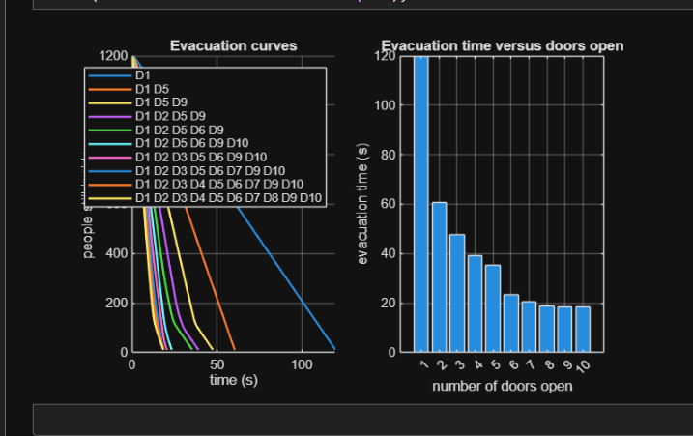
04 · RESULTS
Evacuation curves and time trend
All 10 configurations evacuate well within the 1500 s limit (119.9 s → 18.5 s).
Curves start flat (doors running at full capacity) then drop sharply as crowding clears — most visible in the single-door (D1) case, which stays capacity-limited almost the whole time.
Evacuation time falls steeply from 1→6 doors, then flattens — 8→10 doors barely helps (18.8 s → 18.5 s).
Shows a shift from door-limited (few doors: capacity is the bottleneck) to travel-time-limited (many doors: walking distance is the bottleneck).
Key takeaway: the first few doors, especially spread across different walls, give the biggest safety gain; extra doors beyond that give diminishing returns.
Left: people remaining inside vs. time, for each door combination. Right: evacuation time vs. number of doors open.
UGP Progress — Auditorium Evacuation Study
7

Slide 8
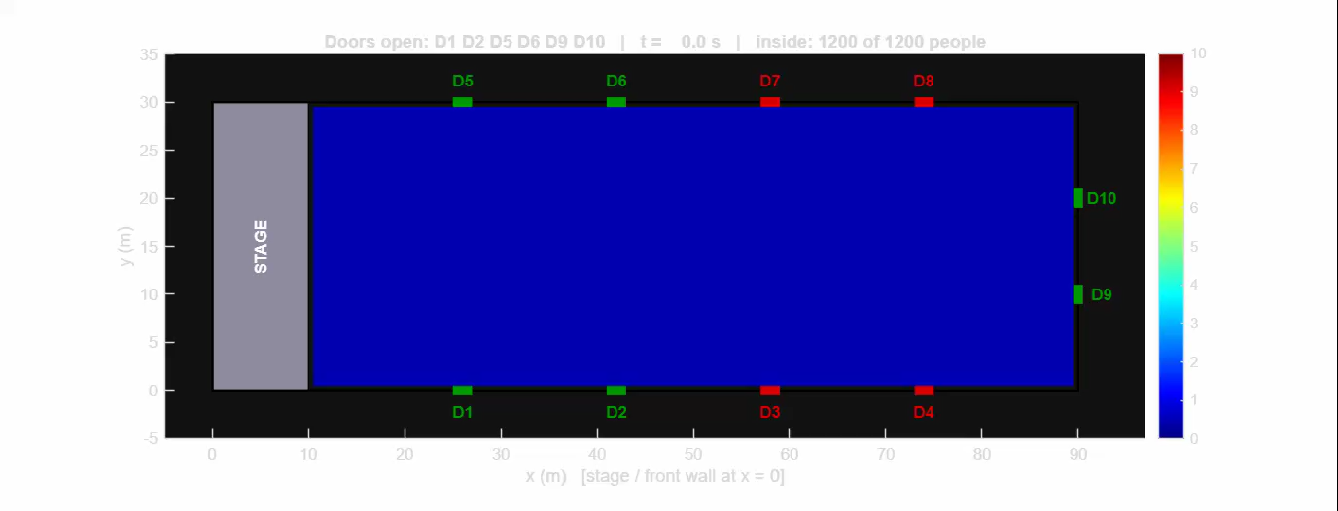
05 · VIDEO DEMONSTRATION
Density videos (per case)
[ Insert Density_Doors_*.mp4 and Velocity_Doors_*.mp4 here before presenting ]
Density video
Velocity video
A color map of crowd density ρ(x,y,t) over the whole floor, updated every 0.5 s. Warm colors mark congestion building up near doors; the stage stays empty throughout the run.
Ten pairs of videos are generated in total — one density + one velocity video for every door combination in the door-opening sequence.
UGP Progress — Auditorium Evacuation Study
8

Slide 9
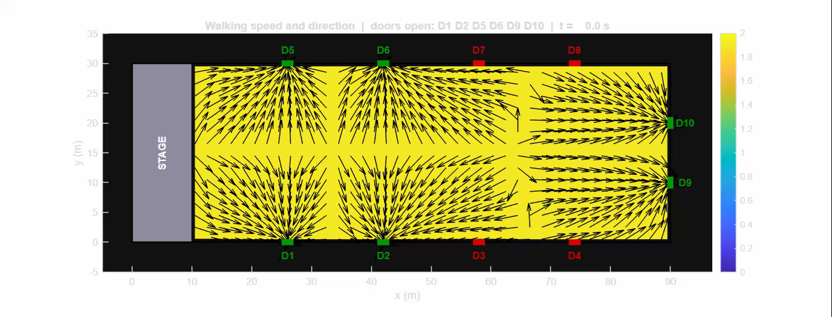
05 · VIDEO DEMONSTRATION
Velocity videos (per case)
[ Insert Density_Doors_*.mp4 and Velocity_Doors_*.mp4 here before presenting ]
Velocity video
Walking speed (color) and direction (arrows) at each point, showing people re-routing toward the nearest open door as queues form near doors and clear once capacity allows.
Ten pairs of videos are generated in total — one density + one velocity video for every door combination in the door-opening sequence.
UGP Progress — Auditorium Evacuation Study
8

Slide 10
06 · KEY OBSERVATIONS
Important points from this stage
1 door is the worst case
With only D1 open, evacuation takes 119.9 s — more than 6× longer than with all doors open, because the whole crowd funnels through one exit.
1
Alternating walls pays off early
Opening the 2nd and 3rd doors on different walls (D5, D9) nearly halves the time again, since it relieves congestion on multiple sides at once rather than crowding one wall further.
2
Sharp diminishing returns
Beyond about 6 open doors (35.5 s → 23.5 s → 20.8 s...), each extra door buys progressively less time — the crowd is no longer door-limited but travel-time-limited.
3
Simulated vs. theoretical minimum
The code also prints a theoretical minimum time from raw door capacity (N_open × D × 5 people/s); the simulated time is higher, correctly capturing queuing and walking-distance effects the theory ignores.
4
Doors matter more than distance
Because the room is long (1:3) and the stage blocks the front, exit choice is dominated by which doors are open, not just how far people start from them.
5
UGP Progress — Auditorium Evacuation Study
9

Slide 11
CONCLUSION & NEXT STEPS
Progress so far, and where this is headed
Conclusions
Next steps
A working macroscopic evacuation simulator has been built and validated: eikonal routing + WENO advection + capacity-limited doors.
Run the special case: same 4 doors reduced to 2 walls only, and compare against the 3-wall result.
Add realistic furniture, rows of seats/chairs and aisles to the currently empty auditorium floor.
For the 10-door auditorium layout, opening doors one by one cuts evacuation time from 119.9 s to 18.5 s.
Explore non-uniform crowd like VIPs, old people, etc.
Benefits are front-loaded: the first few doors (spread across different walls) matter far more than the last few.
Explore non-uniform door widths and asymmetric door placement.
Thank you

